Slide 1

相关与回归分析及其应用(2)
王志恒
Zhiheng.wang@pku.edu.cn
2021.10.27@ PKU, China
Department of Ecology
College of Urban & Environmental Sciences
Peking University

Slide 2
Variance partitioning

Slide 3
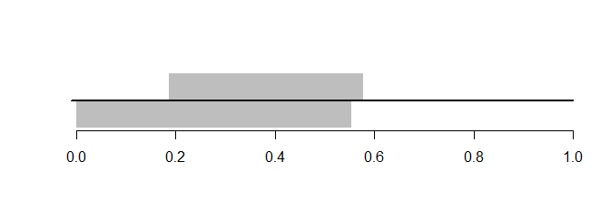
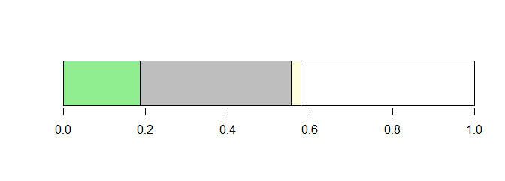
Variance partitioning

Slide 4
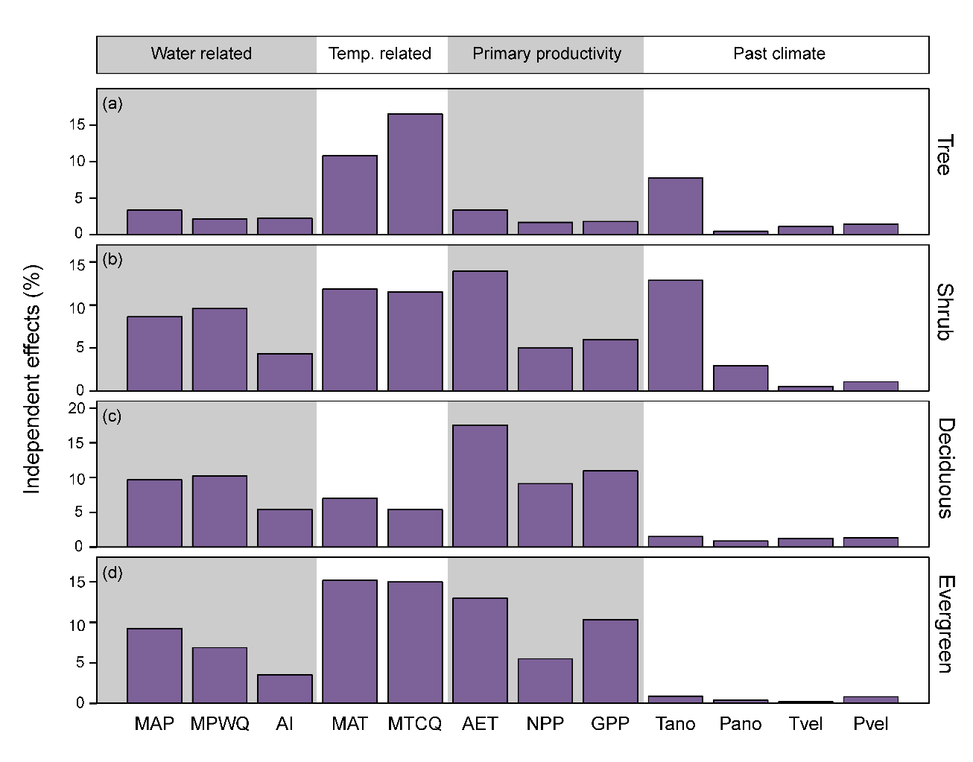
Variance partitioning

Slide 5
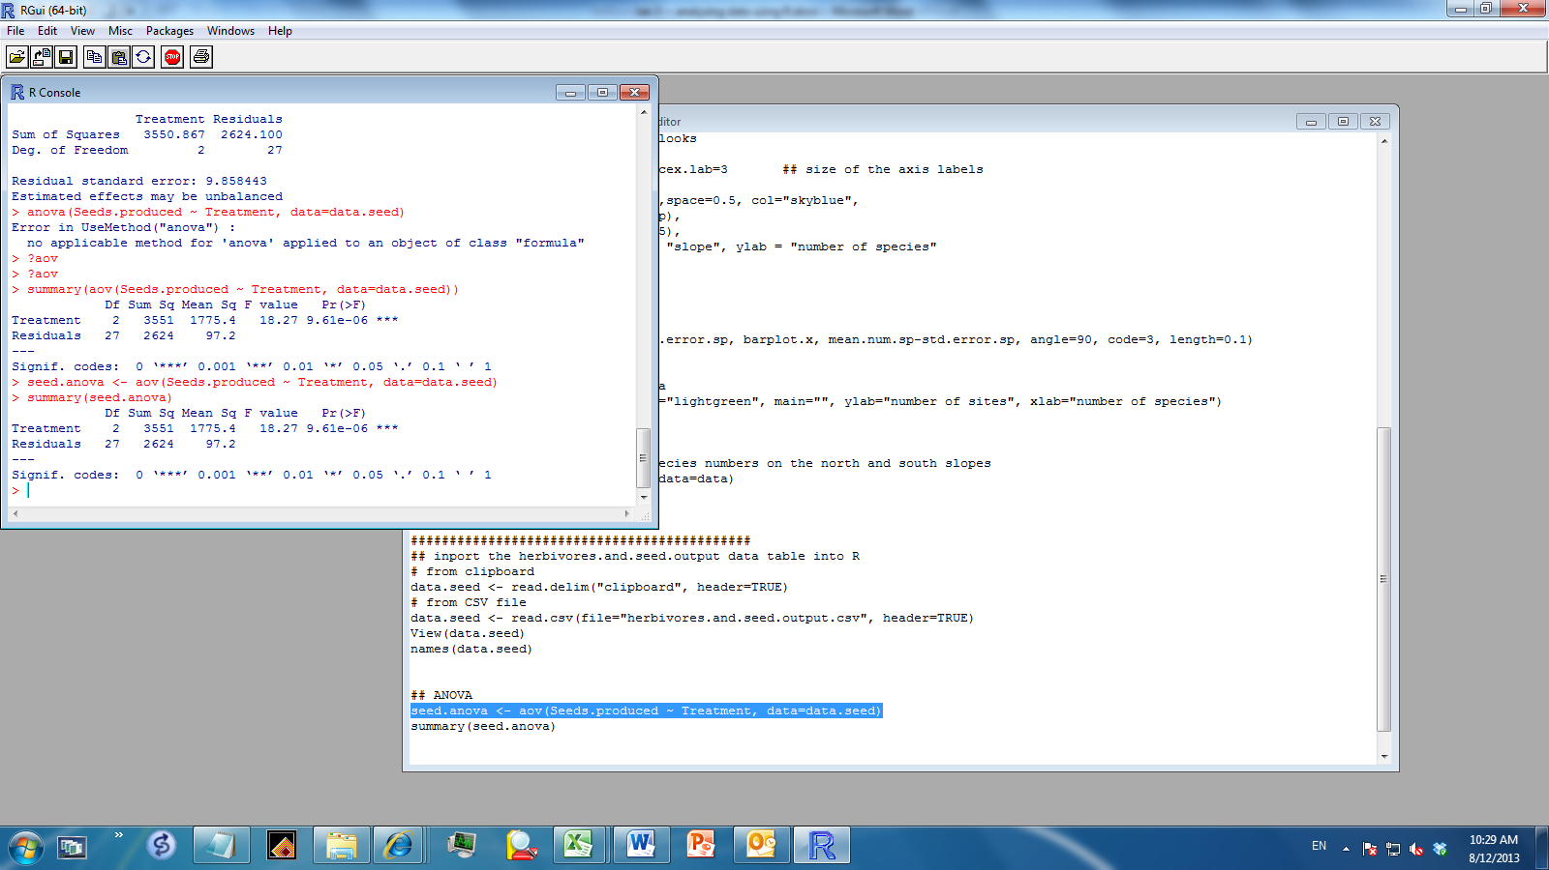
ANOVA
An ANOVA tells you that there is (or isn’t) an effect of a treatment. In other words, it tells you that your treatment affects the response variable. It DOES NOT tell you which samples are bigger or smaller than other samples.
The number of seeds produced by a grassland plant species in 30 plots. 10 plots had rabbits excluded, 10 had deer excluded, and 10 had both rabbits and deer excluded.
## fig an ANOVA model
model = aov()
## show the ANOVA results
summary(model)

Slide 6
ANOVA
Type I regression
Explanatory power of a variable is influenced by its position

Slide 7
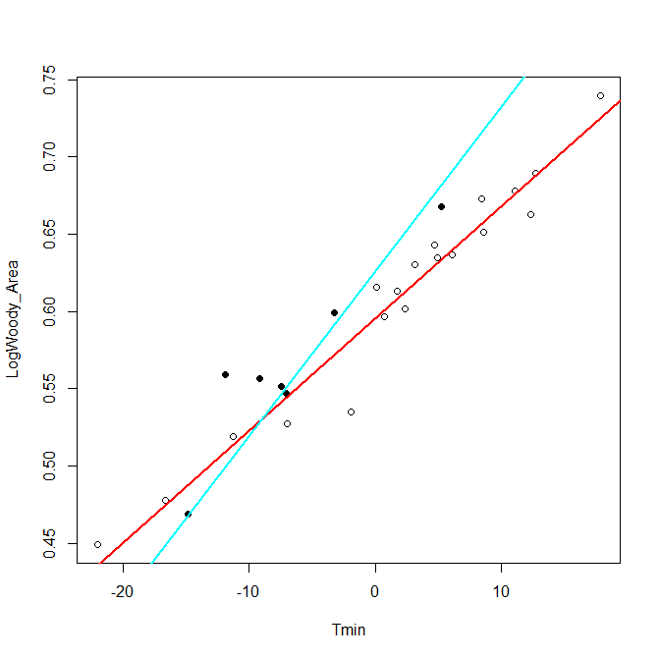
Including interaction terms in general linear models
Are the slopes significantly different from each other?

Slide 8
Including interaction terms in general linear models
Model:
LogWoody_Area ~ Tmin + Biogeo + Tmin * Biogeo
OR
LogWoody_Area = a + b*Tmin + c*Biogeo + d*Tmin * Biogeo
1) When Biogeo == 0
LogWoody_Area = a + b*Tmin
2) When Biogeo == 1
LogWoody_Area = a + b*Tmin + c*1 + d*Tmin*1
= (a + c) + (b + d)*Tmin
Slope difference: b + d vs. b, or b + d – b = d vs. 0
Intercept difference: a + c vs. a, OR a + c – a vs. 0

Slide 9
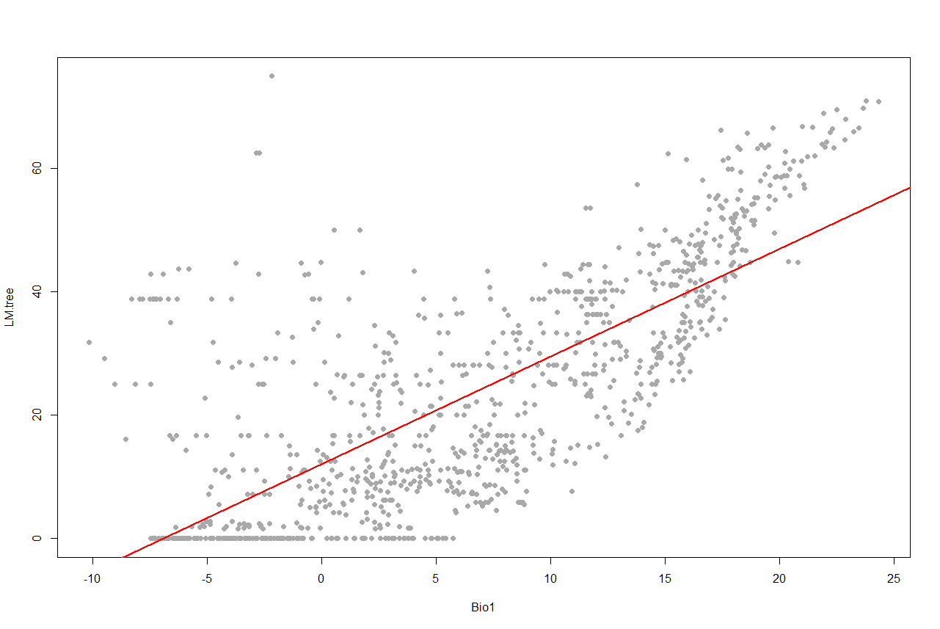
None-linear regressions

Slide 10
None-linear regressions
Y = a*x^b
Log(y) = log(a) + b*log(x)

Slide 11
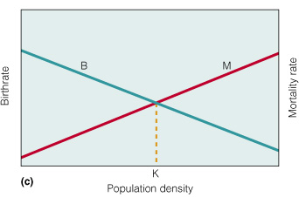
种群增长模型 – 有限环境下的增长
种群增长受环境限制
- 资源是有限的
- 种群密度↑, 对资源的竞争强度↑, 平均资源量↓
- 资源非均匀分布，导致死亡率↑，生殖力↓
- 形成密度依赖的种群增长

Slide 12
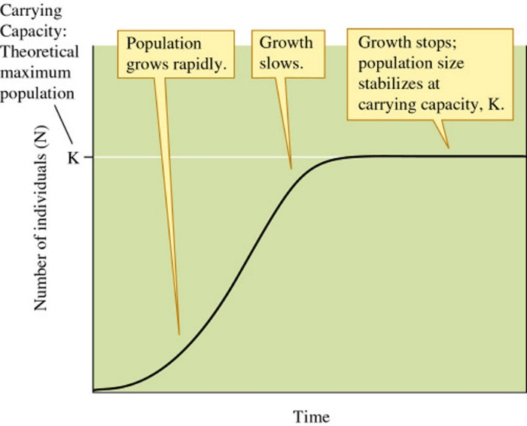
种群增长模型 – 有限环境下的增长
有限环境下的种群增长: 逻辑斯蒂增长
每增加一个个体，对种群增长产生1/K的抑制
dN/dt = rN(1-N/K)
环境承载力(K)：种群增长达到平衡时的种群密度
环境承载力
初期指数增长
中期增长慢
后期停止增长

Slide 13
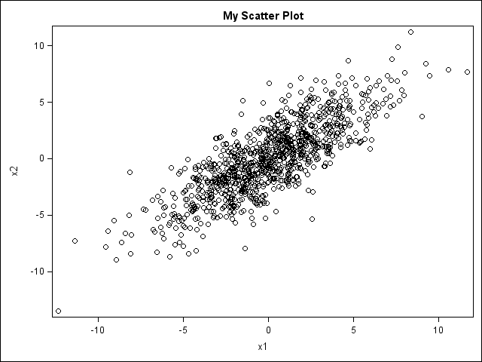
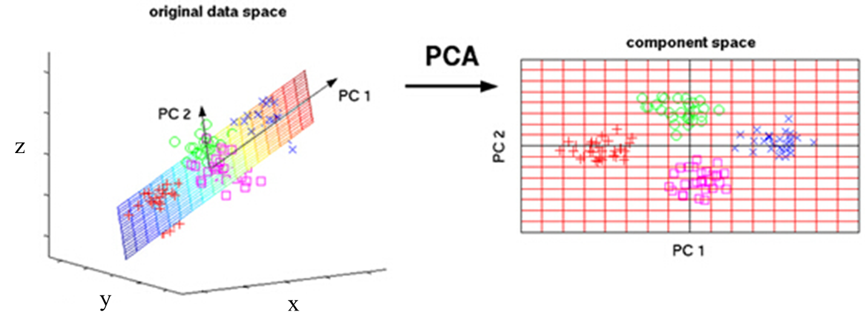
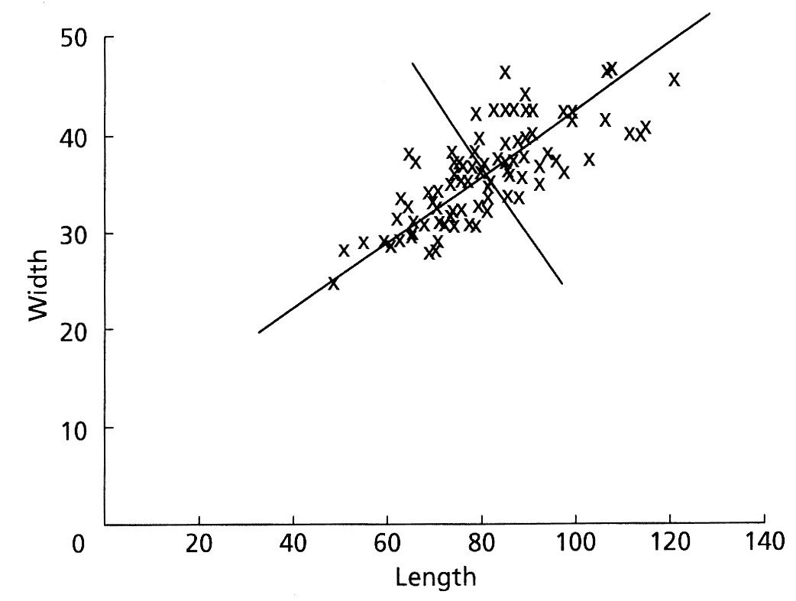
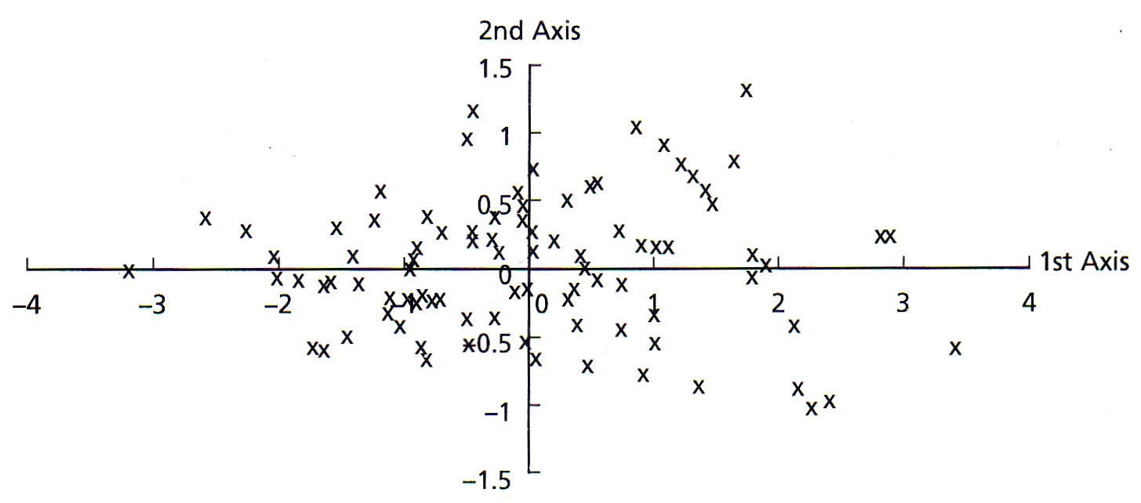
Principal component analysis主成份分析
Notes:
Data Analysis in the Geosciences (uga.edu)

Slide 14
Principal component analysis主成份分析
1.对数据进行标准化
2.求变量的协方差矩阵
3.求协方差矩阵的特征值和特征向量
4.取最大的k个特征值所对应的特征向量
5.将样本点投影到选取的特征向量上

Slide 15
Structure Equation Model (SEM)

Slide 16
Structure Equation Model (SEM)

Slide 17

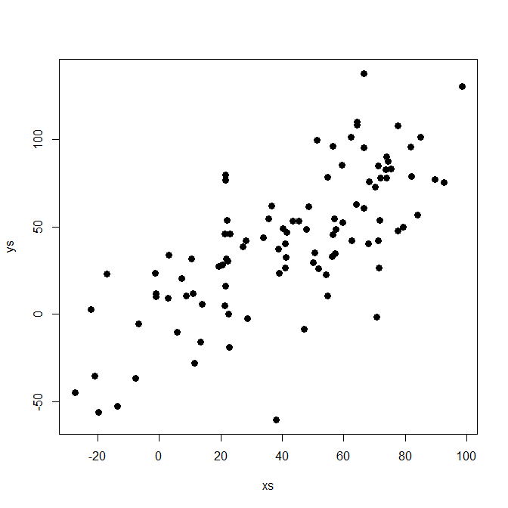
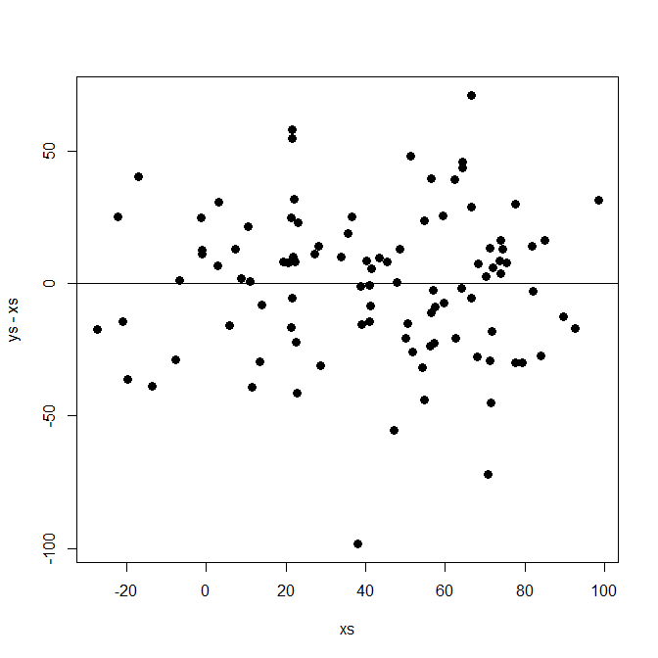
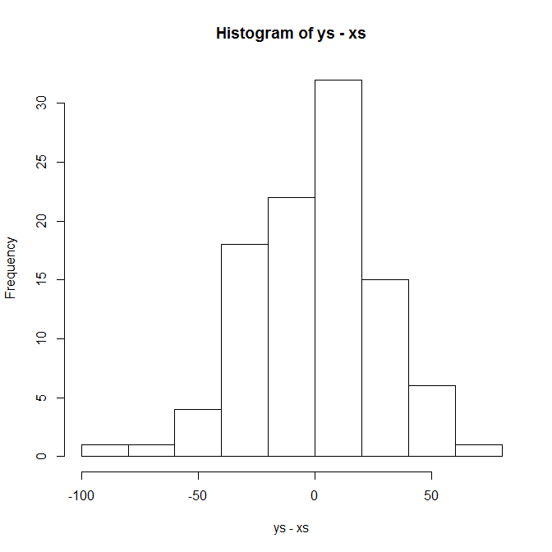
最小二乘回归的假设
y = ax + b + μ
误差项应满足
独立性 cov(μ_{i}, μ_{j}) = 0
正态性 μ_{i} ~N(0, σ²)
等方差性 var(μ_{i}) = σ²
与x不相关 cov(x_{i}, μ_{j}) = 0
y
x
residuals
生态学使用的空间数据大多不符合假设！！
x
residuals
Notes:
Describe that we go from hypotheses about mechanisms to make predictions about relationships.

Slide 18
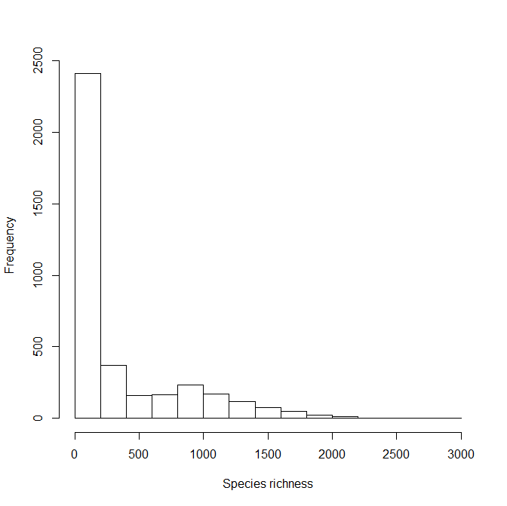
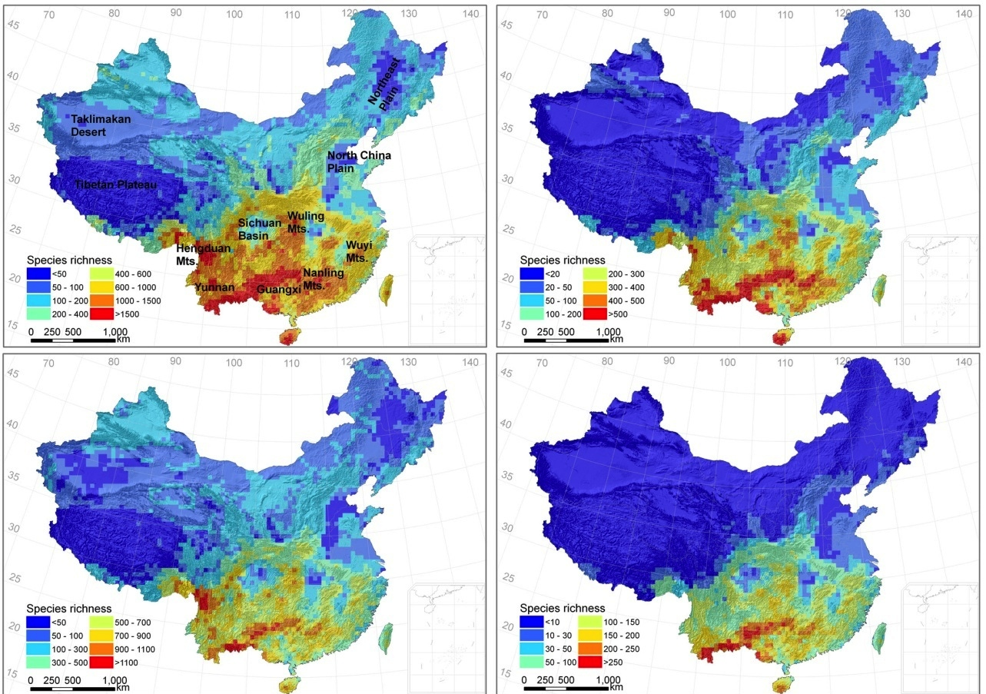
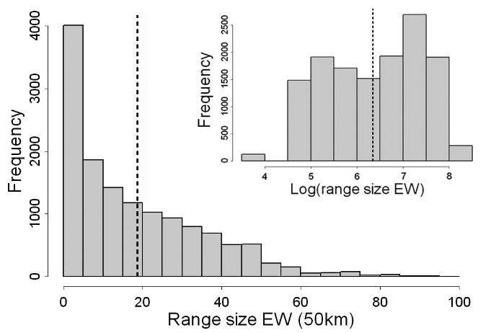
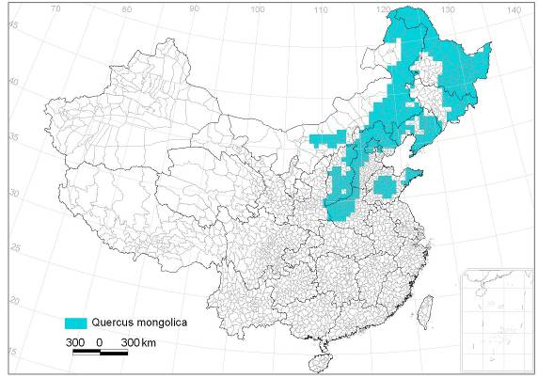
生态学空间数据的频度分布
中国木本植物多样性
中国木本植物分布区大小
Quercus mongolica
Residuals of S ~ MAT

Slide 19
非正态空间数据的回归分析
模型：一般线性模型(Generalized Linear Models, GLM)
特点：可消除非正态残差对模型分析的影响
可选择的残差分布类型
binomial(link = "logit") 二项分布
gaussian(link = “identity”) 高斯分布
Gamma(link = "inverse")
inverse.gaussian(link = "1/mu^2")
poisson(link = “log”) 泊松分布
quasi(link = "identity", variance = "constant")
quasibinomial(link = "logit")
quasipoisson(link = "log")
Negative binomial distribution

Slide 20
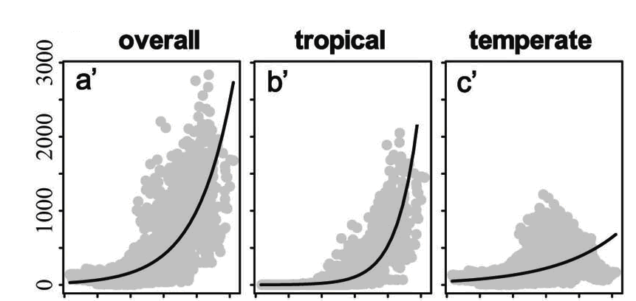
生态学空间数据的频度分布
中国木本植物多样性
GLM with poisson(link = “log”) 泊松分布
物种多样性
冬季低温
植物分布区
Quercus mongolica
GLM with binomial(link = "logit") 二项分布
物种分布模型的一种

Slide 21
谢谢！

